Slide 1
Lecture 6: Multi-view geometry
Notes:
we introduced image formation last class
we’re going into a bit more depth about 3d geometry
and how you might be able to estimate depth from multiple images.

Slide 2
Announcements
Jun’s start date at Michigan is pushed back to January
Bernadette is the sole instructor for the course
Will be out of town the week of Sept 29th (office hours cancelled and lecture plan TBD)

Slide 3
Announcements
PS2 released and due Wednesday
First lecture quiz (they are very short) out today and due in 24 hours

Slide 4
Today
Epipolar geometry
Stereo matching
Image alignment
Notes:
Going to continue our discussion of multi-view geometry. And we’re going to talk about applications you can do with these. One is estimating depth from images. Called the stereo problem.

Slide 5
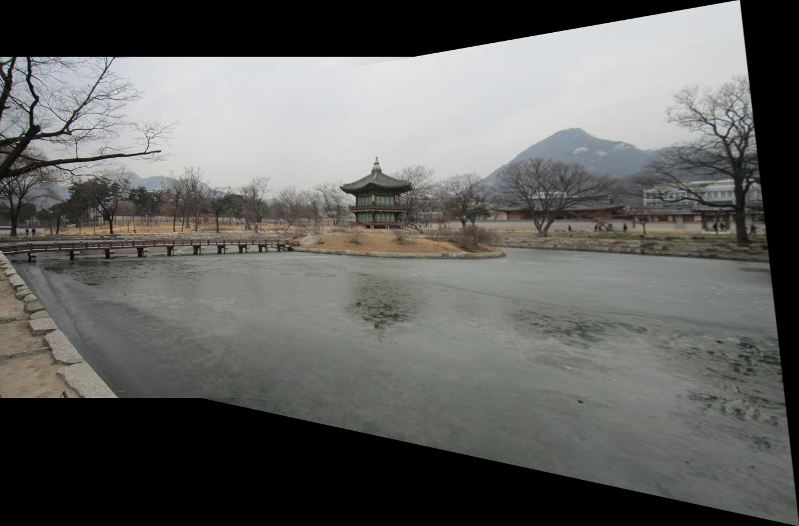


PS3: making panoramas
Source: N. Snavely

Slide 6

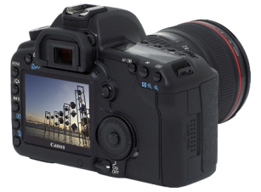
Recall: camera parameters
Camera
(x, y, z)
COP
Three important coordinate systems:
World coordinates
Camera coordinates
Image coordinates
“The World”
How do we project a given world point (x, y, z) to an image point?
Source: N. Snavely

Slide 7
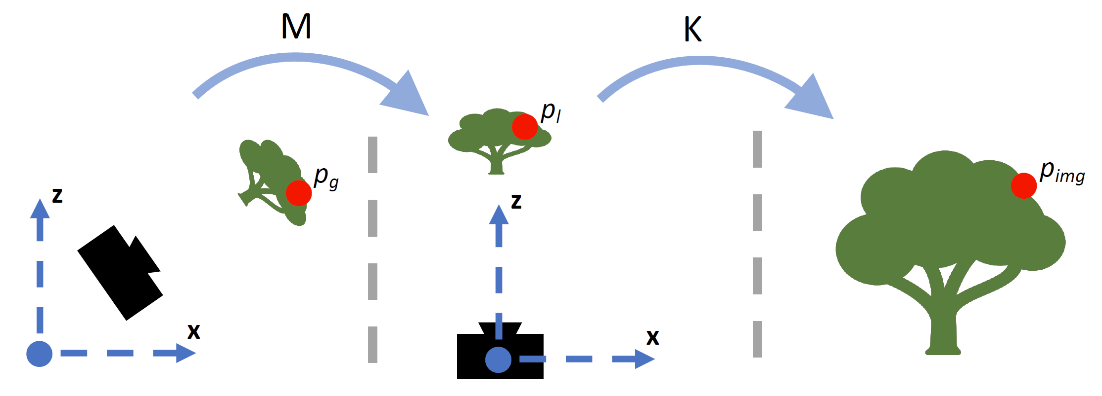
Coordinate frames
World coordinates
Camera coordinates
Image coordinates
Source: N. Snavely
Figure credit: Peter Hedman

Slide 8
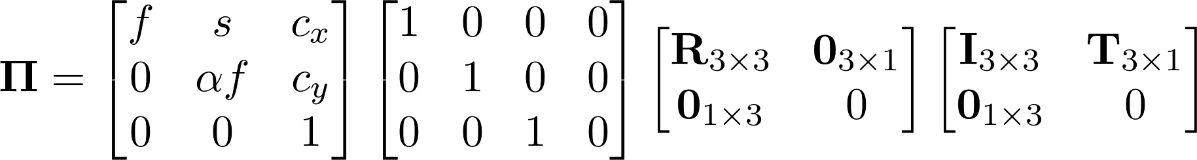
Recall: camera parameters
intrinsics
rotation
translation
Source: N. Snavely

Slide 9
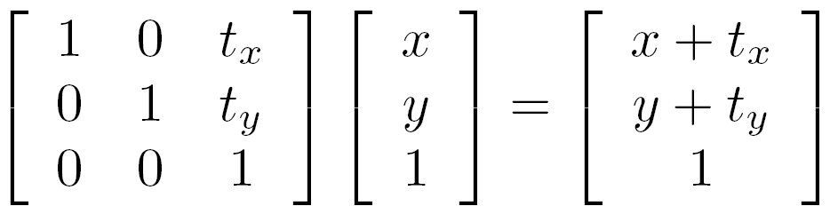
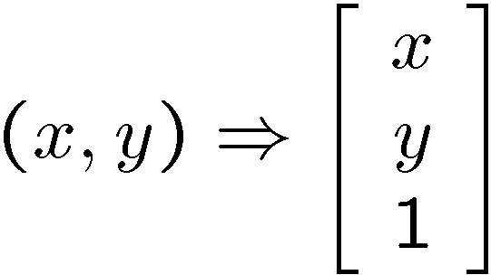
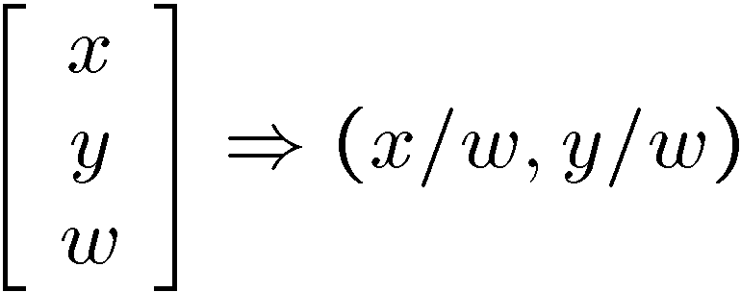
Recall: homogeneous coordinates
Representing translations:
homogeneous image
coordinates
Converting back to image coordinates
Source: N. Snavely

Slide 10










Projection matrix
=
0
(in homogeneous image coordinates)
Source: N. Snavely

Slide 11
Estimating depth from multiple views
Notes:
We’ve learned geometry. Let’s use it to solve a problem.

Slide 12
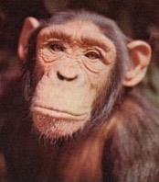
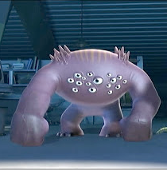

Vision systems
Two cameras
N cameras
One camera

Slide 13

Stereo vision
~6cm
~50cm
Source: Torralba, Isola, Freeman
Notes:
seeing things in 3D is really important for animals. and even though it’s really expensive to have an eye, we actually have two of them.
one of the reasons for this is of course that we can see a wider field of view
but also it’s because it helps us estimate the 3D structure of a scene.
This is called stereo vision.

Slide 14

1 vs. 2 eyes
Source: Torralba, Isola, Freeman
Notes:
so what do we get out of having multiple eyes

Slide 15

1 vs. 2 eyes
Source: Torralba, Isola, Freeman
Notes:
these two pictures of an office look pretty similar. But if we look at the differences between them, we can estimate depth.

Slide 16
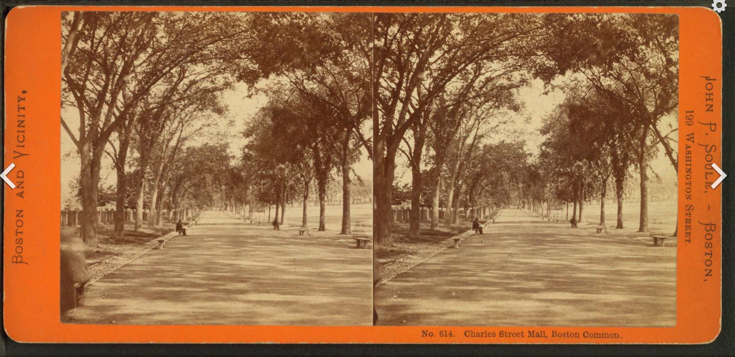
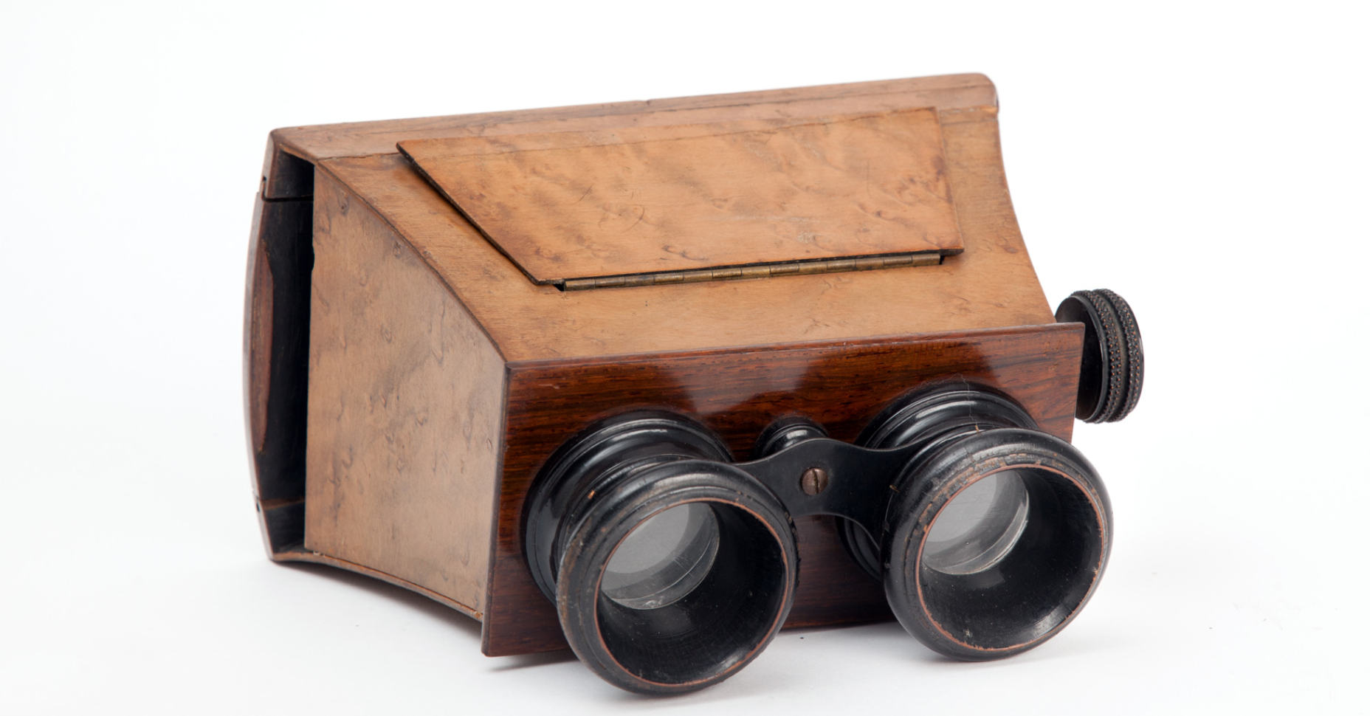
Stereoscopic card
Brewster stereoscope
Image source: wikipedia
Source: Torralba, Isola, Freeman
Notes:
Even in the 19th century One of your sample final projects
How does this work? How are we able to perceive depth from stereo images?
Used to be up for debate how humans do this.
as it a really high level procedure?
do we need to know what the objects are?
do we need to know categories?

Slide 17


1, 2, N eyes
Source: Torralba, Isola, Freeman
Notes:
we could even do more and in principle we could get even more information.
Now researchers a long time ago weren’t really sure how people performed stereopsis.
was it a really high level procedure?
do we need to know what the objects are?
do we need to know categories?

Slide 18
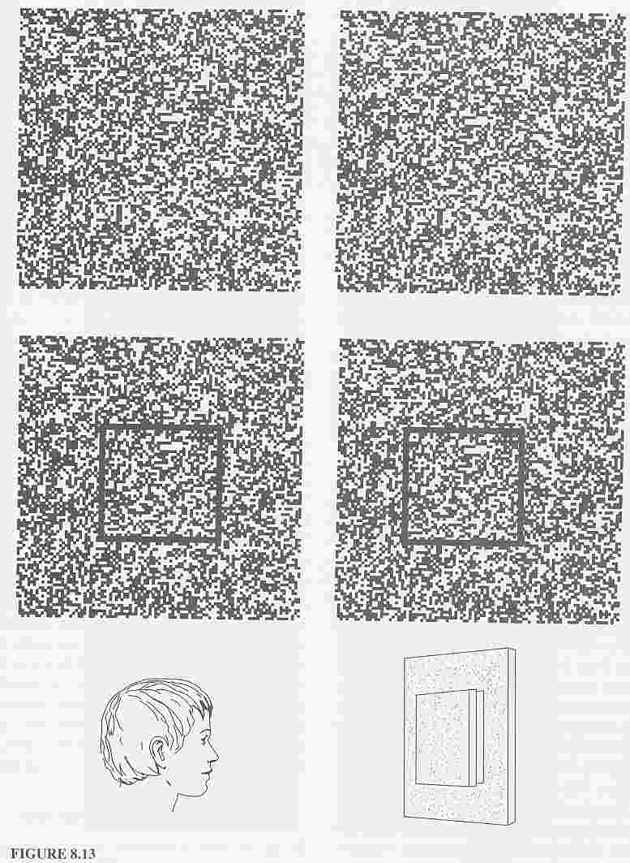
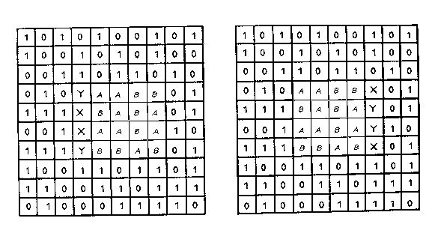
Depth without objects
Julesz, 1971
Source: Torralba, Isola, Freeman
Notes:
Interestingly, in humans we seem to be able to get the perception of depth from relatively low-level cues. This is very closely related to a magic eye puzzle.
A researcher named Bela Julesz made these things that he called random dot stereograms
These are two images that consist of random dots. And these are almost the same, but there’s one
Tiny change.
There’s a square region of random dots is subtly shifted.
And if you show someone these two images in each eye, they’ll perceive this. The box is extending out.
And of course you can do this with normal pictures.
We can ask what’s going on here geometrically.

Slide 19
Geometry for a simple stereo system
Observed Point
Z₁
x_{L}
Focal Length
f
X₁
Center of Projection - i.e. where we are seeing the point from
Source: Torralba, Isola, Freeman
Notes:
Let’s look the geometry of what’s going on.
We have a pinhole camera seeing a 3D point.
And that point’s going to project somewhere in the image.
We’re going to trace a line from the point to the center of projection
Let’s call the distance from the distance xL

Slide 20
Geometry for a simple stereo system
Z₁
Z?
Depth
x_{L}
f
X₁
Source: Torralba, Isola, Freeman
Notes:
This depth Z is what we’re really interested in. We want to know how far in front of us this point is.

Slide 21
Geometry for a simple stereo system
Z₁
Z₂
Z?
x_{L}
x_{R}
f
f
X₁
X₂
T
Source: Torralba, Isola, Freeman
Notes:
And likewise, if we’re seeing it from another view at position xR.
If we know how far away these two cameras are, we have all we need to estimate depth.
Let’s call that distance T
And the two cameras are going to have some focal length f
This has a very nice geometric structure.

Slide 22
Geometry for a simple stereo system
Z₁
Z₂
Can we estimate Z?
Z?
x_{L}
x_{R}
f
f
X₁
X₂
T
Source: Torralba, Isola, Freeman
Notes:
And likewise, if we’re seeing it from another view at position xR.
If we know how far away these two cameras are, we have all we need to estimate depth.
Let’s call that distance T
And the two cameras are going to have some focal length f
This has a very nice geometric structure.

Slide 23
Geometry for a simple stereo system
Z₁
Z₂
Z?
x_{L}
x_{R}
f
f
X₁
X₂
T
Source: Torralba, Isola, Freeman
Notes:
And likewise, if we’re seeing it from another view at position xR.
If we know how far away these two cameras are, we have all we need to estimate depth.
Let’s call that distance T
And the two cameras are going to have some focal length f
This has a very nice geometric structure.

Slide 24
Geometry for a simple stereo system
Z₁
Z₂
Z?
x_{L}
x_{R}
f
f
X₁
X₂
T
Similar triangles
Source: Torralba, Isola, Freeman
Notes:
We can use similar triangles to

Slide 25
Geometry for a simple stereo system
Z₁
Z₂
Z?
x_{L}
x_{R}
f
f
X₁
X₂
T
Similar triangles
Source: Torralba, Isola, Freeman

Slide 26
Geometry for a simple stereo system
Z₁
Z₂
Similar triangles:
Z?
T
x_{L}
x_{R}
Z
f
f
X₁
X₂
T
Source: Torralba, Isola, Freeman
Notes:
Is the same as the ratio between the baseline — the distance between the cameras — and the depth

Slide 27
Geometry for a simple stereo system
Z₁
Z₂
Similar triangles:
Z?
T+X_{R}-X_{L}
T
=
x_{L}
x_{R}
Z-f
Z
f
f
X₁
X₂
T
Source: Torralba, Isola, Freeman
Notes:
We know that the ratio between the distance between these two projected points. And the distance from the image to the object

Slide 28
Geometry for a simple stereo system
Z₁
Z₂
Similar triangles:
Z?
T+X_{R}-X_{L}
T
=
x_{L}
x_{R}
Z-f
Z
f
f
X₁
X₂
Solving for Z:
Disparity
T
T
Z = f
X_{L} - X_{R}
Source: Torralba, Isola, Freeman
Notes:
Of course we can then solve for depth by rearranging the terms.

Slide 29


In 3D
camera 1
camera 2
T
Source: Torralba, Isola, Freeman
Notes:
This is what this looks like in 3D. Different 3D points project into cameras.
So, this idea gives us a formula. If we know the baseline T, and the disparity, we can estimate depth.

Slide 30
Disparity map
Left image
Right image
Second picture is ~1m to the right
Source: Torralba, Isola, Freeman

Slide 31
Disparity map
Left image
Right image
Source: Torralba, Isola, Freeman

Slide 32
Disparity map
Left image
Right image
Source: Torralba, Isola, Freeman

Slide 33
Disparity map
I’(x,y)
I(x,y)
I’(x,y) = I(x+D(x,y), y)
Depth
Focal Length
Disparity Map
f
D(x,y)
Z(x,y) =
D(x,y)
Disparity
Source: Torralba, Isola, Freeman
Notes:
This gives us what’s known as a disparity map. And that determines our depth. Our depth is proportional to the inverse of the disparity.

Slide 34
Finding correspondences
We only need to search for matches along horizontal lines.
Source: Torralba, Isola, Freeman
Notes:
What was need about this is we only had to look along horizontal lines.These are called epipolar lines.

Slide 35
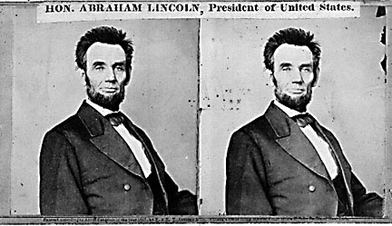
Basic stereo algorithm
For each “epipolar line”
For each pixel in the left image
compare with every pixel on same epipolar line in right image
pick pixel with minimum match cost
Source: R. Szeliski
Notes:
This gives us a really simple
Any ideas for how you’d do this?

Slide 36
Computing disparity
Source: Torralba, Isola, Freeman

Slide 37
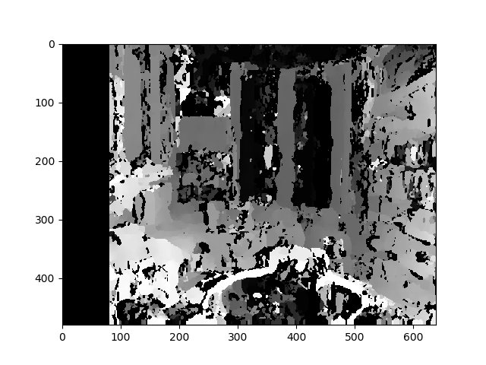

Computing disparity
Opencv (3.4.1) and python 3.6.5
import cv2
from matplotlib import pyplot as plt
imgL = cv2.imread('input1.jpg', 0)
imgR = cv2.imread('input2.jpg', 0)
stereo = cv2.StereoSGBM_create(numDisparities=80, blockSize=15)
disparity = stereo.compute(imgL, imgR)
plt.imshow(disparity, 'gray')
plt.show()

Slide 38
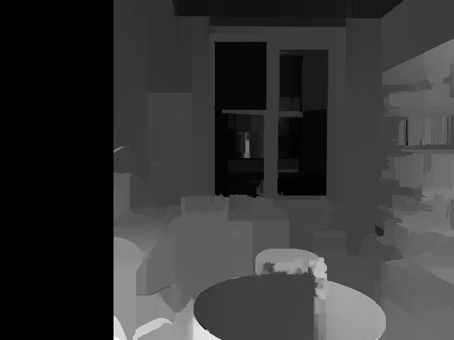
Computing disparity
Semi-global matching [Hirschmüller 2008]
Source: Torralba, Isola, Freeman
Notes:
We need to smooth the results a bit. Otherwise ambiguous matches will look bad.
Any idea what’s going on here?

Slide 39
Computing disparity
Semi-global matching [Hirschmüller 2008]

Slide 40
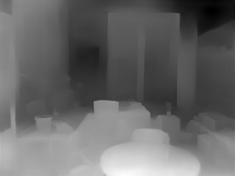

Can also learn depth from a single image
Source: Torralba, Isola, Freeman
Notes:
And of course there are others ways we could have estimated depth. For example, using a neural network to recognize depth at each pixel.
Humans rely a lot on this.

Slide 41
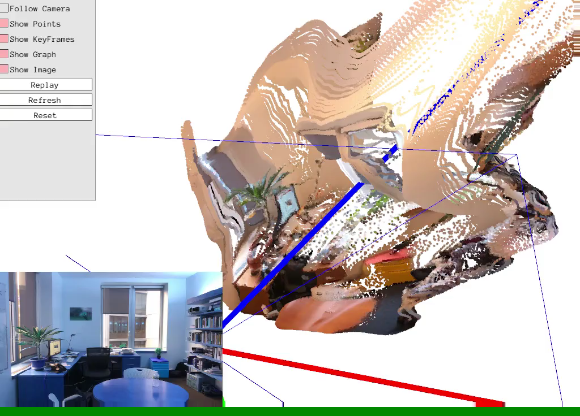
Manually adjusting the focal length, to something that looks reasonable...

Slide 42
N eyes
Source: Torralba, Isola, Freeman
Notes:
we could even do more and in principle we could get even more information.
Now researchers a long time ago weren’t really sure how people performed stereopsis.
was it a really high level procedure?
do we need to know what the objects are?
do we need to know categories?

Slide 43
General case
The two cameras need not have parallel optical axes.
Source: Torralba, Isola, Freeman

Slide 44
Source: Torralba, Isola, Freeman

Slide 45
Do we need to search for matches only along horizontal lines?
Source: Torralba, Isola, Freeman

Slide 46
Do we need to search for matches only along horizontal lines?
Source: Torralba, Isola, Freeman

Slide 47
Do we need to search for matches only along horizontal lines?
It looks like we might need to search everywhere... are there any constraints
that can guide the search?
Source: Torralba, Isola, Freeman
Notes:
At first, this might seem really hopeless. It looks at first glance like we might have to search everywhere.
Are there extra constraints we could take advantage of?

Slide 48
Stereo correspondence constraints
Camera 1
Camera 2
p’ ?
O
O’
If we see a point in camera 1, are there any constraints on where we
will find it on camera 2?
Source: Torralba, Isola, Freeman
Notes:
Let’s think about this. If we see at a point p in the image. Let’s think of lal the possible places it could appear in the second view

Slide 49
Stereo correspondence constraints
p’ ?
p
O
O’
Source: Torralba, Isola, Freeman
Notes:
The only thing that’s unknown is the depth. So the true point has to lie along this ray. It has to be one of these point.
Let’s look at where those end up in the other image. They’re all along a line!
If we could just find this line,

Slide 50
Stereo correspondence constraints
p’ ?
p
O
O’
Source: Torralba, Isola, Freeman
Notes:
The only thing that’s unknown is the depth. So the true point has to lie along this ray. It has to be one of these point.
Let’s look at where those end up in the other image. They’re all along a line!
If we could just find this line,

Slide 51
Epipolar constraint
p’ ?
p
O
O’
Source: Torralba, Isola, Freeman

Slide 52
Some terminology
p’ ?
p
O
O’
Source: Torralba, Isola, Freeman

Slide 53
Some terminology
p’ ?
p
Baseline
O
O’
Baseline: the line connecting the two camera centers
Epipole: point of intersection of baseline with the image plane
Source: Torralba, Isola, Freeman

Slide 54
Some terminology
p’ ?
p
epipole
Baseline
epipole
O
O’
Baseline: the line connecting the two camera centers
Epipole: point of intersection of baseline with the image plane
Source: Torralba, Isola, Freeman

Slide 55
Some terminology
epipolar plane
p’ ?
p
O
O’
Baseline: the line connecting the two camera centers
Epipole: point of intersection of baseline with the image plane
Epipolar plane: the plane that contains the two camera centers and a 3D point in the world
Source: Torralba, Isola, Freeman
Notes:
Consider this plane that connects the episode and contains the point.
That’s going to dictate where the epipolar line is.

Slide 56
Some terminology
epipolar line
epipolar line
p’ ?
p
O
O’
Baseline: the line connecting the two camera centers
Epipole: point of intersection of baseline with the image plane
Epipolar plane: the plane that contains the two camera centers and a 3D point in the world
Epipolar line: intersection of the epipolar plane with each image plane
Source: Torralba, Isola, Freeman

Slide 57
Epipolar constraint
epipolar line
p’ ?
p
O
O’
We can search for matches across epipolar lines
All epipolar lines intersect at the epipoles
Source: Torralba, Isola, Freeman
Notes:
That means we can really drastically cut our search space. We only have to look along this line.

Slide 58



Epipolar constraint
p’
p
O
O’
If we observe a point in one image, its position in the other image is constrained to lie on the epipolar line.
How do we get this line? We want a function that, given a point tells us what this line is:
such that
where . In other words

Slide 59

The fundamental matrix
p’
p
O
O’
It can be shown that our function, f, can be written as a matrix multiplication in homogeneous coordinates.
F: fundamental matrix
p image point in homogeneous coordinates
Notes:
- You can prove that this mysterious function f can be completely described by a matrix multiplication with
Fundamental matrix
draw

Slide 60

The fundamental matrix
p’
p
O
O’
It can be shown that our function, f, can be written as a matrix multiplication in homogeneous coordinates.
More concisely:
F: fundamental matrix
p image point in homogeneous coordinates
Source: Torralba, Isola, Freeman

Slide 61

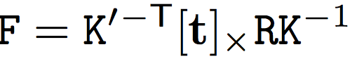
The fundamental matrix
p’
p
O
O’
Closely related to projection matrix:
K, K’: intrinsics matrices
R, t: relative pose
See Hartley and Zisserman for derivation

Slide 62
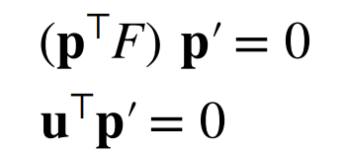
The fundamental matrix
p’
p
O
O’
u: a line induced by p
p, p’: image points in homogeneous coordinates
Closely related to projection matrix:
K, K’: intrinsics matrices
R, t: relative pose
See Hartley and Zisserman for derivation

Slide 63
The fundamental matrix
p’
p
O
O’
If we observe a point in one image, its position in the other image is constrained to lie on line defined by above.
u^{T} p’ = 0
u: a line induced by p
p, p’: image points in homogeneous coordinates

Slide 64

The essential matrix
p’
p
O
O’
If we observe a point in one image, its position in the other image is constrained to lie on line defined by above.
p^{T} E p’ = 0
E: essential matrix
p, p’: image points in homogeneous coordinates
Intrinsics

Slide 65
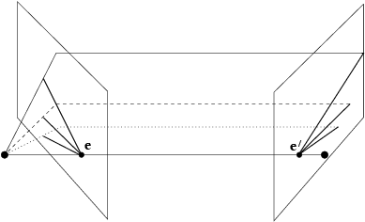
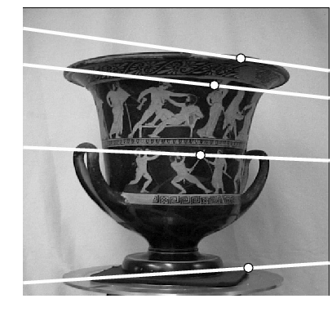
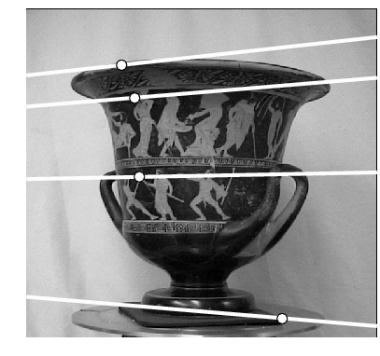
Example: converging cameras
Figure from Hartley & Zisserman
Source: Kristen Grauman

Slide 66
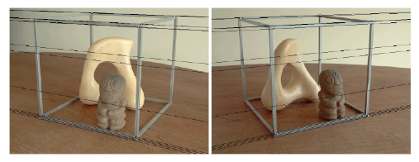
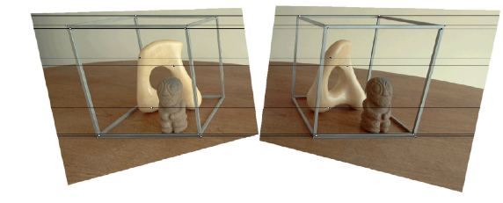
Image rectification
Source: A. Efros
Notes:
You can actually rectify the images so that these lines all become horizontal.
Stereo perception is also the basis of a lot of so-called depth cameras that you might have seen.

Slide 67
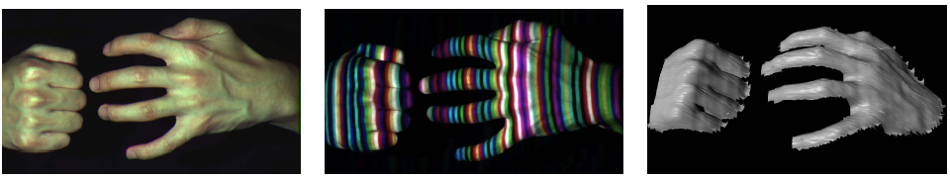

Active stereo with structured light
camera 1
camera 1
projector
projector
camera 2
Easy-to-match pattern
Do we really need the second camera?
[Zhang, Curless, Seitz, 2002]
Source: R. Szeliski
Notes:
Untextured regions
Matching hard problem
Make it easier.

Slide 68
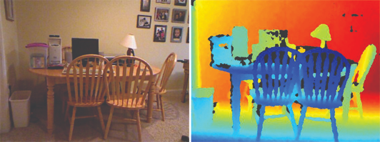
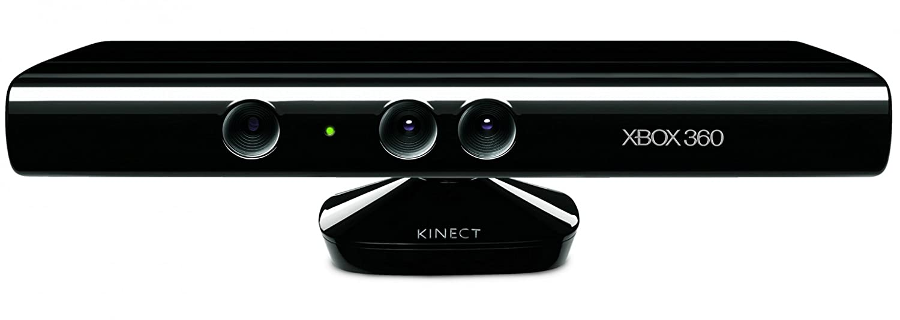
RGB-D sensors
Infrared projector
RGB camera
Infrared camera
CSE 576, Spring 2008
Stereo matching
Notes:
You might be familiar with some of these. This is one called the Microsoft kinect. It was made originally for playing video games.
Another thing we can do with this understanding of geometry.

Slide 69
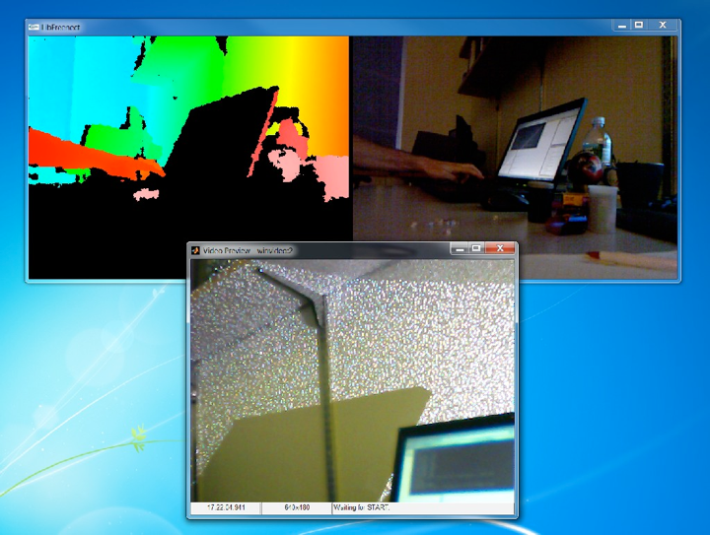
CSE 576, Spring 2008
Stereo matching

Slide 70
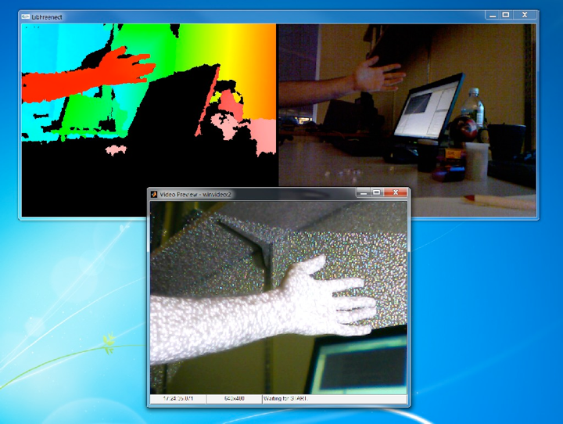

Slide 71
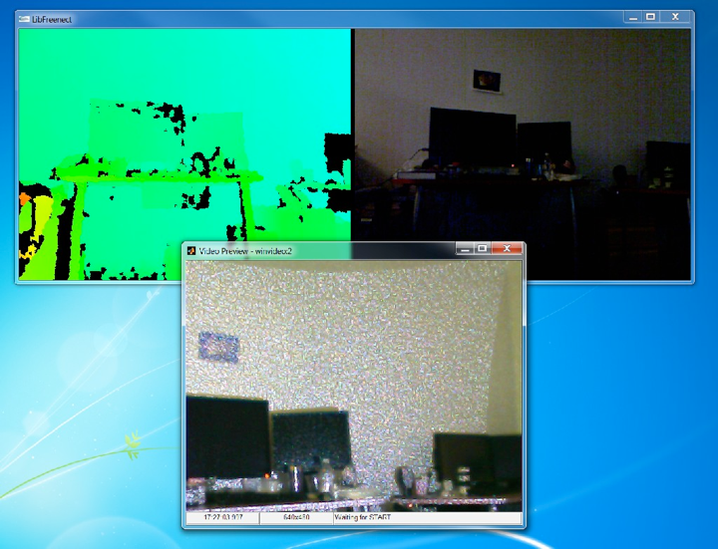

Slide 72
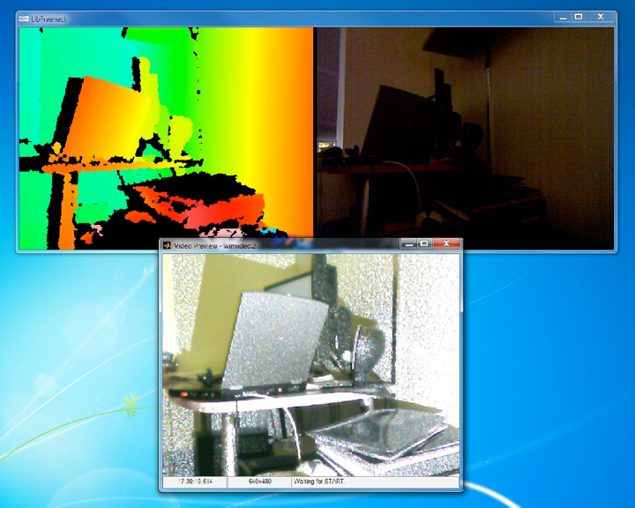

Slide 73
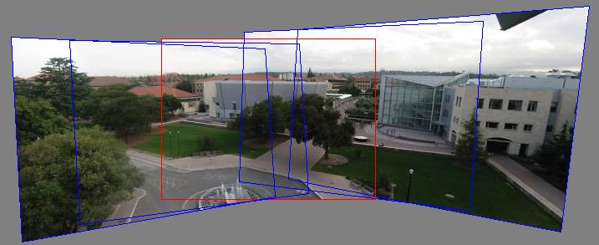
Making panoramas
Source: N. Snavely

Slide 74
Making panoramas

Slide 75
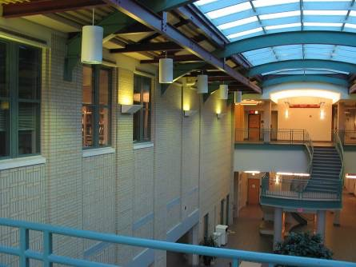
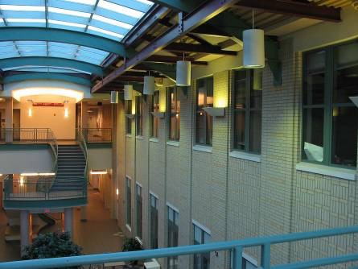
What is the geometric relationship between these two images?
?

Slide 76
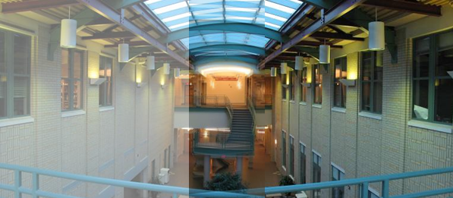
Image alignment
Why don’t these image line up exactly?
Source: N. Snavely
Notes:
Can we take advantage of the geometry to do better?
What if we warp the images first?

Slide 77

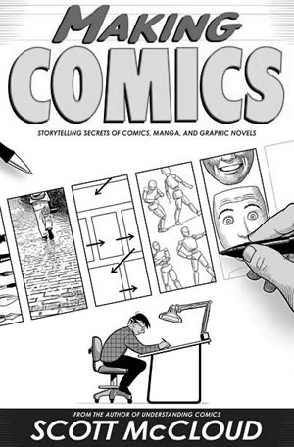
What is the geometric relationship between these two images?
?
Answer: Similarity transformation (translation, rotation, uniform scale)

Slide 78
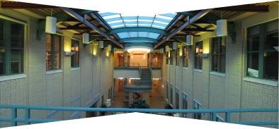
What is the geometric relationship between these two images?
Very important for creating mosaics!

Slide 79
Image Warping
image filtering: change range of image
g(x) = h(f(x))
image warping: change domain of image
g(x) = f(h(x))
f
g
h
x
x
f
g
h
x
x
Richard Szeliski
Image Stitching

Slide 80

Image Warping
image filtering: change range of image
g(x) = h(f(x))
image warping: change domain of image
g(x) = f(h(x))
f
g
h
f
g
h
Richard Szeliski
Image Stitching

Slide 81
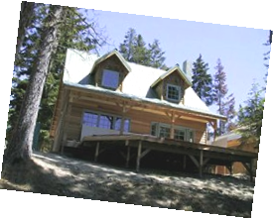
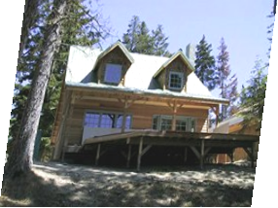
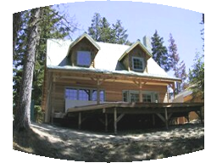
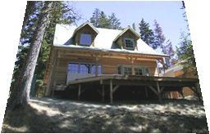
Parametric (global) warping
Examples of parametric warps:
translation
rotation
aspect
perspective
affine
cylindrical
Richard Szeliski
Image Stitching

Slide 82
Parametric (global) warping
Examples of parametric warps:
translation
rotation
aspect
Richard Szeliski
Image Stitching

Slide 83
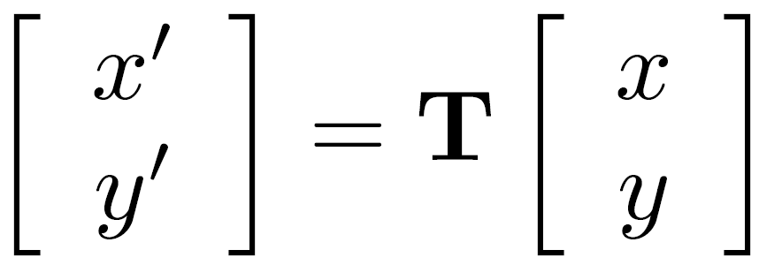

Parametric (global) warping
T
p = (x,y)
p’ = (x’,y’)
Transformation T is a coordinate-changing machine:
p’ = T(p)
What does it mean that T is global?
  Is the same for any point p
  can be described by just a few numbers (parameters)
Let’s consider linear xforms (can be represented by a 2D matrix):

Slide 84
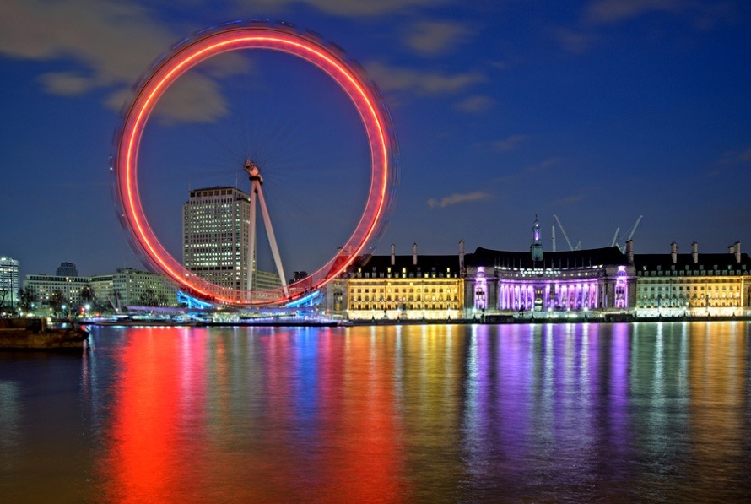

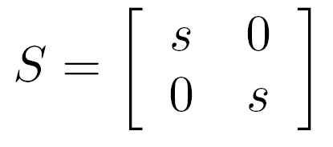

Common linear transformations
Uniform scaling by s:
(0,0)
(0,0)
What is the inverse?

Slide 85
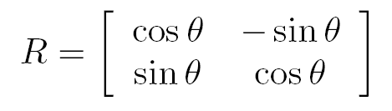


Common linear transformations
Rotation by angle θ (about the origin)
θ
(0,0)
(0,0)
What is the inverse?
For rotations:

Slide 86
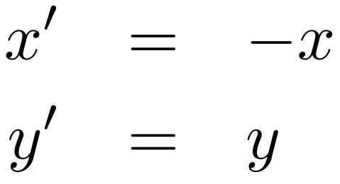
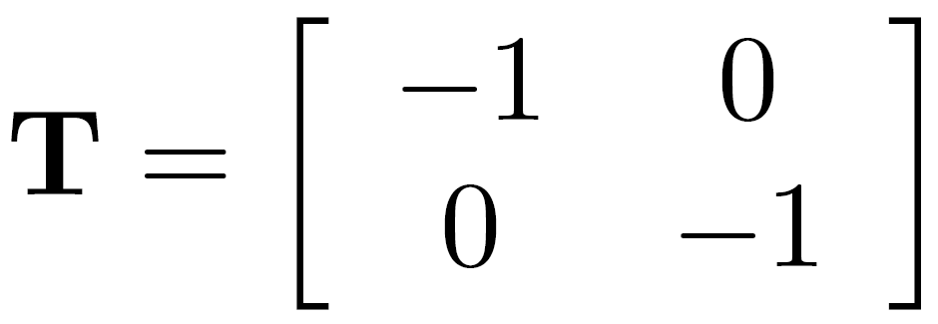
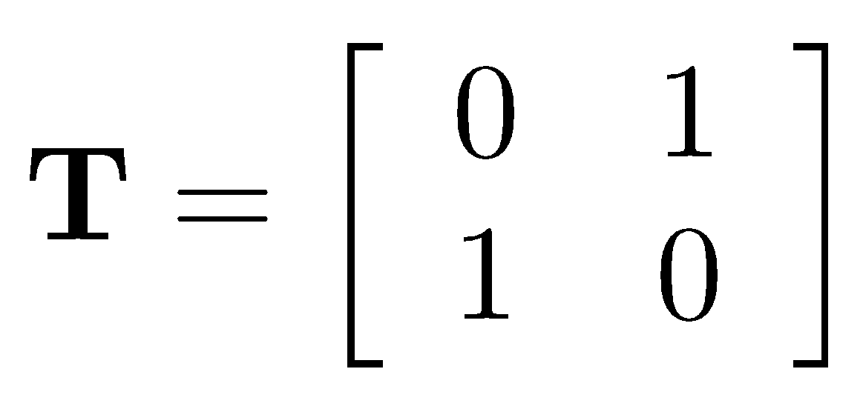
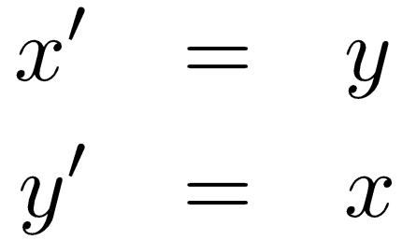
2x2 Matrices
What types of transformations can be
represented with a 2x2 matrix?
2D mirror about Y axis?
2D mirror across line y = x?

Slide 87

2x2 Matrices
What types of transformations can be
represented with a 2x2 matrix?
2D Translation?
NO!
Translation is not a linear operation on 2D coordinates

Slide 88


All 2D Linear Transformations
Linear transformations are combinations of …
  Scale,
  Rotation,
  Shear, and
  Mirror
Properties of linear transformations:
  Origin maps to origin
  Lines map to lines
  Parallel lines remain parallel
  Ratios are preserved
  Closed under composition

Slide 89


Homogeneous coordinates
(x, y, w)
Trick: add one more coordinate:
homogeneous plane
(x/w, y/w, 1)
homogeneous image
coordinates
Converting from homogeneous coordinates

Slide 90

Translation
Solution: homogeneous coordinates to the rescue

Slide 91

Affine transformations
any transformation with
last row [ 0 0 1 ] we call an
affine transformation

Slide 92




Basic affine transformations
Translate
Scale
2D in-plane rotation
Shear

Slide 93

Affine Transformations
Affine transformations are combinations of …
  Linear transformations, and
  Translations
Properties of affine transformations:
  Origin does not necessarily map to origin
  Lines map to lines
  Parallel lines remain parallel
  Ratios are preserved
  Closed under composition

Slide 94
Is this an affine transformation?

Slide 95
Homographies

Slide 96
Recall: affine transformations
what happens when we change this row?
affine transformation
Source: N. Snavely
Notes:
Affine, but won’t be enough.

Slide 97





Projective Transformations aka Homographies aka Planar Perspective Maps
Called a homography
(or planar perspective map)
Source: N. Snavely
Notes:
These are going to let us do some powerful things

Slide 98


Homographies
Note that this can be 0!
A “point at infinity”
Source: N. Snavely
Notes:
This is the full-blown matrix.

Slide 99
Homographies
Example on board

Slide 100
Points at infinity
Source: N. Snavely

Slide 101
Homography
Example: two pictures taken by rotating the camera:
If we try to build a panorama by overlapping them:
Source: Torralba, Isola, Freeman

Slide 102
Homography
Example: two pictures taken by rotating the camera:
With a homography you can map both images into a single camera:
Source: Torralba, Isola, Freeman

Slide 103
Homography
(x₁,y₁)
(x’₁,y’₁)
x₁’
y₁’
w₁
a | b | c
d | e | f
g | h | i
x₁
y₁
1
=
.
Source: Torralba, Isola, Freeman

Slide 104







Why does this work?
Image 2
Step 1: Convert pixels in image 2 to rays in camera 2’s coordinate system.
Optical Center
Step 2: Convert rays in camera 2’s coordinates to rays in camera 1’s coordinates.
Image 1
Step 3: Convert rays in camera 1’s coordinates to pixels in image 1’s coordinates.
How do we map points in image 2 into image 1?
image 1
image 2
intrinsics
extrinsics
(rotation only)
3x3 homography
Source: N. Snavely
Notes:
You might ask why this works. How can you explain this transformation with just a homography.
Transform image 2 to image 1 when they differ only by H

Slide 105





Plane-to-plane homography
image plane in front
image plane below
black area
where no pixel
maps to
Source: N. Snavely
Notes:
There are also a bunch of other really cool things you can do with homographies.
You can simulate what a plane would look like if you viewed it from another camera.
Warp this image with a homography
Warp this one with another one
What are these artifacts?

Slide 106

Homographies
Homographies …
  Affine transformations, and
  Projective warps
Properties of projective transformations:
  Origin does not necessarily map to origin
  Lines map to lines
  Parallel lines do not necessarily remain parallel
  Closed under composition
Source: N. Snavely
Notes:
Removed: Ratios are not preserved

Slide 107


2D image transformations
Source: N. Snavely

Slide 108
How do we perform this warp?

Slide 109
RANSAC for estimating homography
RANSAC loop:
Select four feature pairs (at random)
Compute homography H (exact)
Compute inliers where ||p_{i}’, H p_{i}|| < ε
Keep largest set of inliers
Re-compute least-squares H estimate using all of the inliers

Slide 110
Simple example: fit a line
Rather than homography H (8 numbers)
fit y=ax+b (2 numbers a, b) to 2D pairs
76

Slide 111
Simple example: fit a line
Pick 2 points
Fit line
Count inliers
3 inlier
77

Slide 112
Simple example: fit a line
Pick 2 points
Fit line
Count inliers
4 inlier
78

Slide 113
Simple example: fit a line
Pick 2 points
Fit line
Count inliers
9 inlier
79

Slide 114
Simple example: fit a line
Pick 2 points
Fit line
Count inliers
8 inlier
80

Slide 115
Simple example: fit a line
Use biggest set of inliers
Do least-square fit

Slide 116
Homographies

Slide 117
Image warping
Given a coordinate transformation (x’,y’) = T(x,y) and a source image f(x,y), how do we compute a transformed image g(x’,y’) = f(T(x,y))?
y
T(x,y)
y’
x
x’
f(x,y)
g(x’,y’)
Source: N. Snavely
Notes:
Map T from pixel locations in one image to another

Slide 118
Forward warping
Send each pixel f(x) to its corresponding location (x’,y’) = T(x,y) in g(x’,y’)
What if a pixel lands “between” two pixels?
y
T(x,y)
y’
x
x’
f(x,y)
g(x’,y’)
Source: N. Snavely

Slide 119
Forward warping
Send each pixel f(x) to its corresponding location (x’,y’) = T(x,y) in g(x’,y’)
What if a pixel lands “between” two pixels?
Answer: add “contribution” to several pixels, normalize later (splatting)
Can still result in holes
y
T(x,y)
y’
x
x’
f(x,y)
g(x’,y’)
Source: N. Snavely
Notes:
Can anyone think of some complications.

Slide 120
Forward Warping
Send each pixel f(x,y) to its corresponding location x’ = h(x,y) in g(x’,y’)
What if pixel lands “between” two pixels?
Answer: add “contribution” to several pixels, normalize later (splatting)
Can still result in holes
y
T(x,y)
y’
x
x’
f(x,y)
g(x’,y’)

Slide 121
Inverse warping
Get each pixel g(x’,y’) from its corresponding location (x,y) = T⁻¹(x,y) in f(x,y)
Requires taking the inverse of the transform
What if pixel comes from “between” two pixels?
y
T⁻¹(x,y)
y’
x
x’
f(x,y)
g(x’,y’)
Source: N. Snavely

Slide 122
Inverse warping
Get each pixel g(x’) from its corresponding location x’ = h(x) in f(x)
What if pixel comes from “between” two pixels?
Answer: resample color value from interpolated source image
T⁻¹(x,y)
y
y’
x
x’
f(x,y)
g(x’,y’)
Source: N. Snavely

Slide 123

Interpolation
Possible interpolation filters:
  nearest neighbor
  bilinear
  bicubic (interpolating)
  sinc
Needed to prevent “jaggies”
and aliasing artifacts
(with prefiltering)
Source: N. Snavely

Slide 124
Next lecture: estimating geometry from images

Slide 125
Image warping

Slide 126
Image alignment
Why don’t these image line up exactly?

Slide 127
What is the geometric relationship between these two images?
?
Answer: Similarity transformation (translation, rotation, uniform scale)

Slide 128
What is the geometric relationship between these two images?
?

Slide 129
What is the geometric relationship between these two images?
Very important for creating mosaics!

Slide 130
Image Warping
image filtering: change range of image
g(x) = h(f(x))
image warping: change domain of image
g(x) = f(h(x))
f
g
h
f
g
h
Richard Szeliski
Image Stitching

